Slide 1
KITSUNE LoRa BBM Board

Slide 2
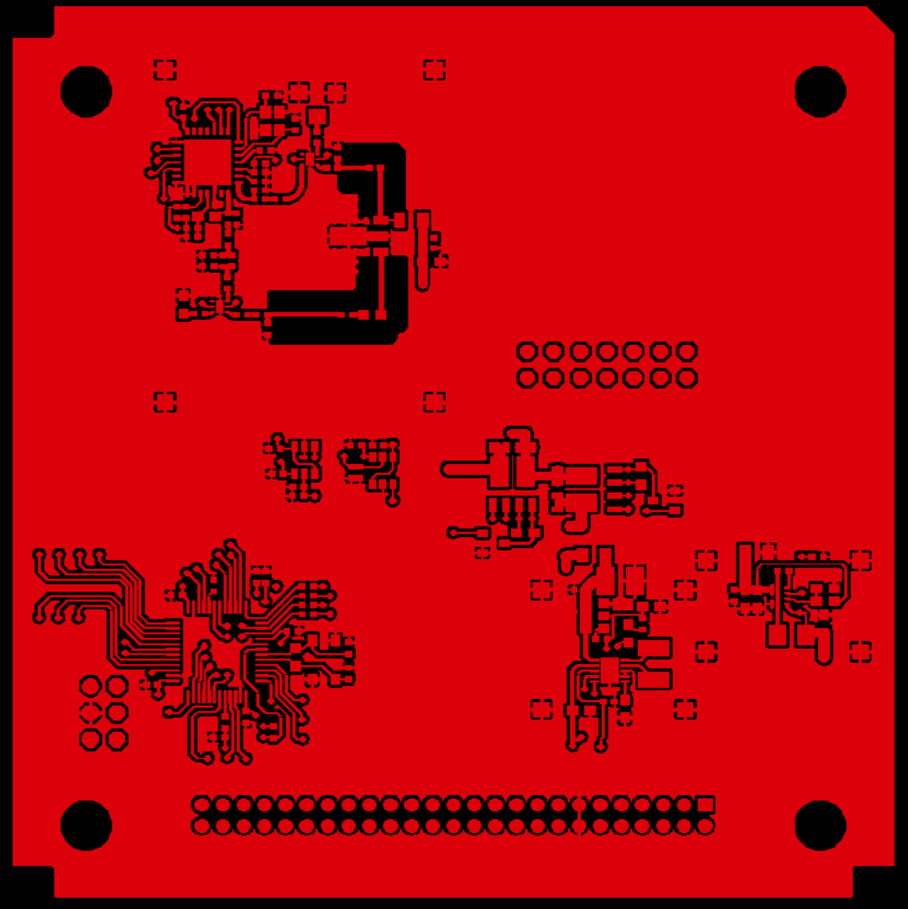
TOP LAYER

Slide 3
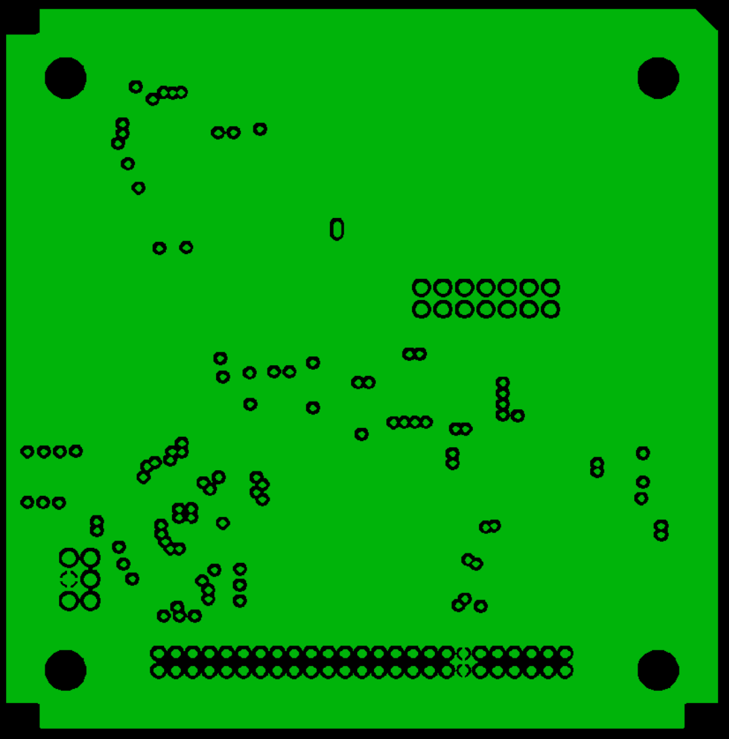
LAYER 2 (GND PLANE)

Slide 4
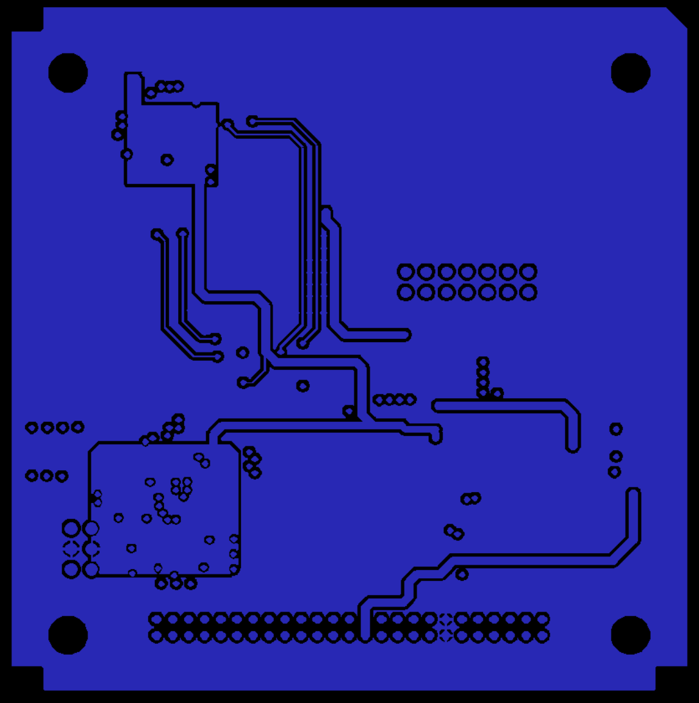
LAYER 3 (PWR PLANE)

Slide 5
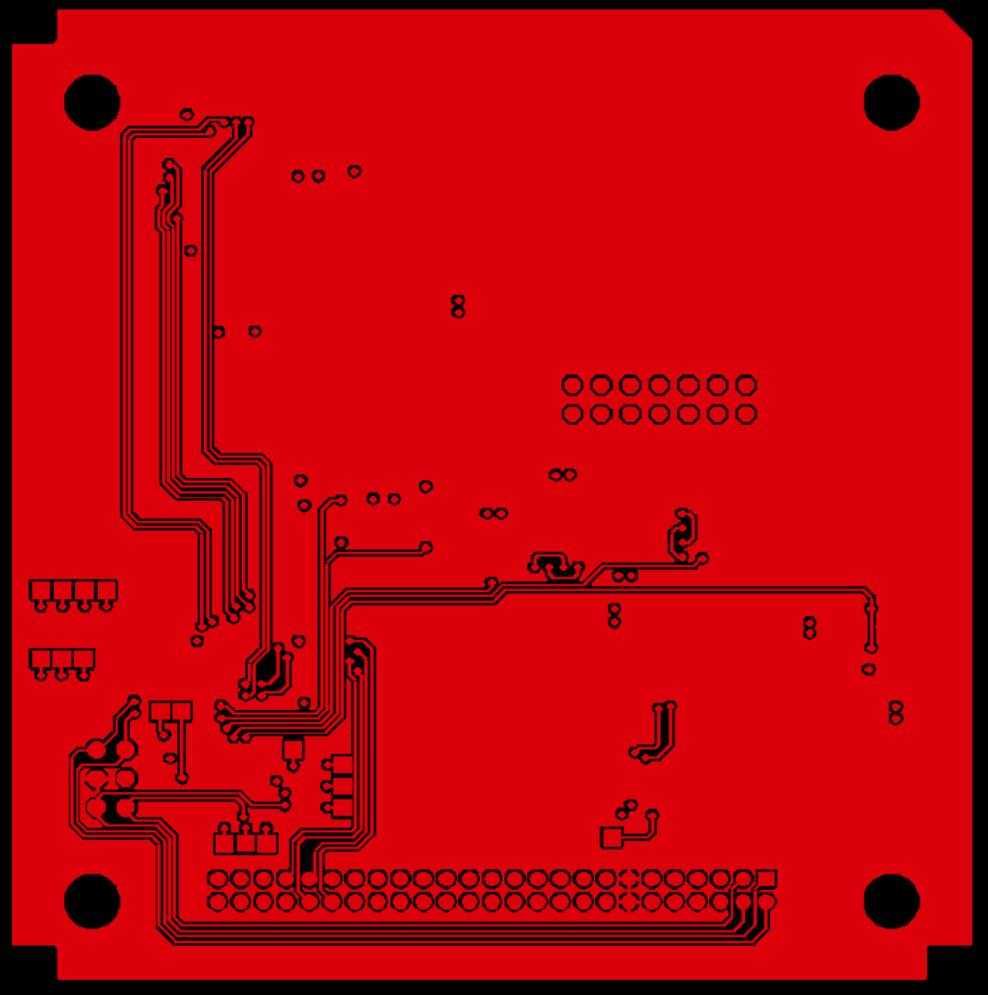
BOTTOM LAYER (By looking from top side)

Slide 6
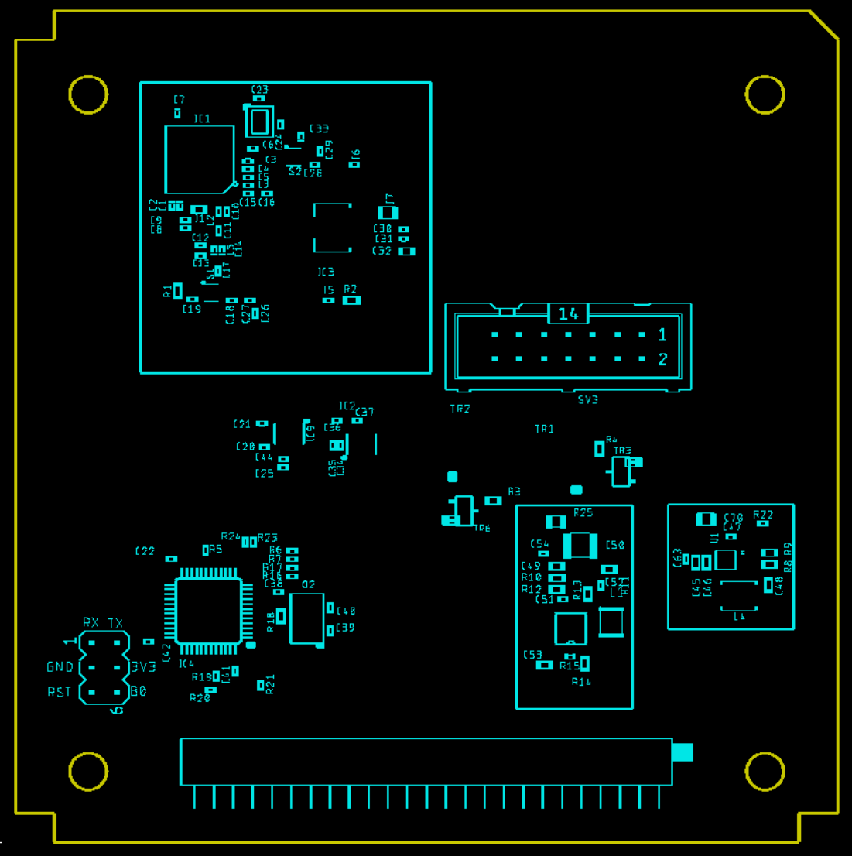
TOP SILK

Slide 7
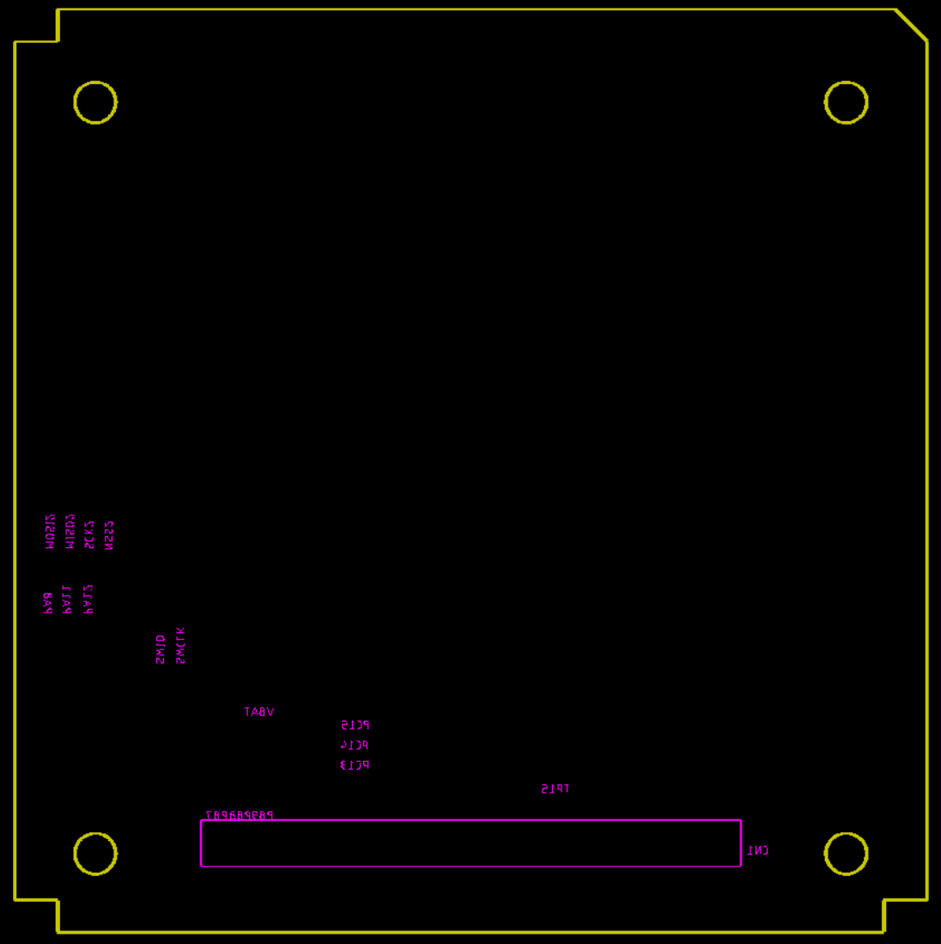
Bottom Silk

Slide 8
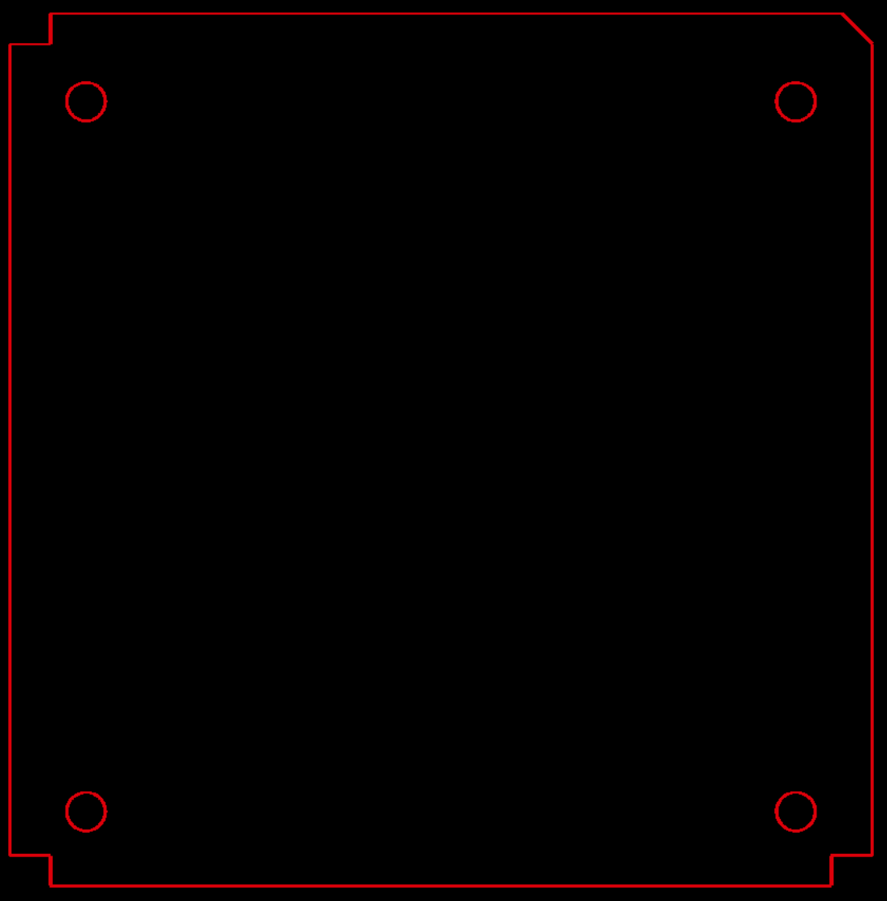
BOARD OUTLINE

Slide 9
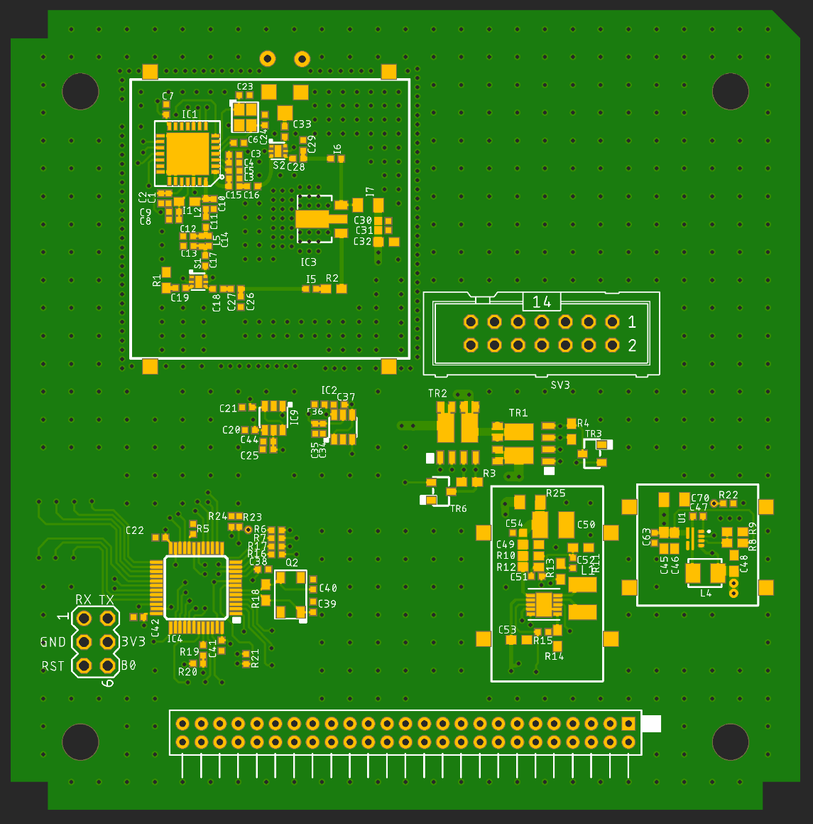
MOUNTING DRAWING - 1

Slide 10
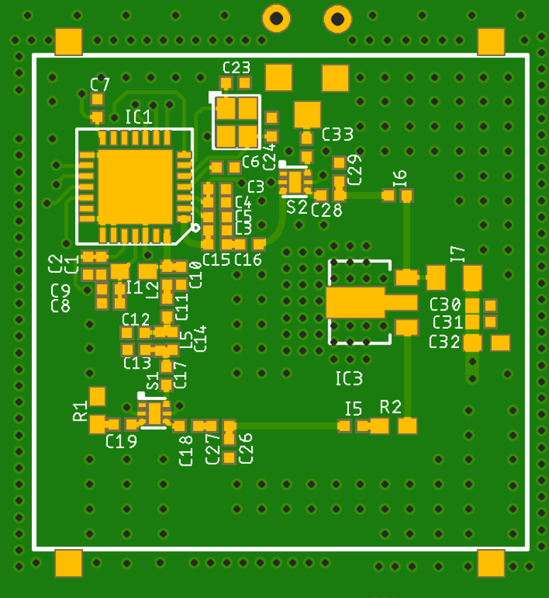
MOUNTING DRAWING - 2

Slide 11
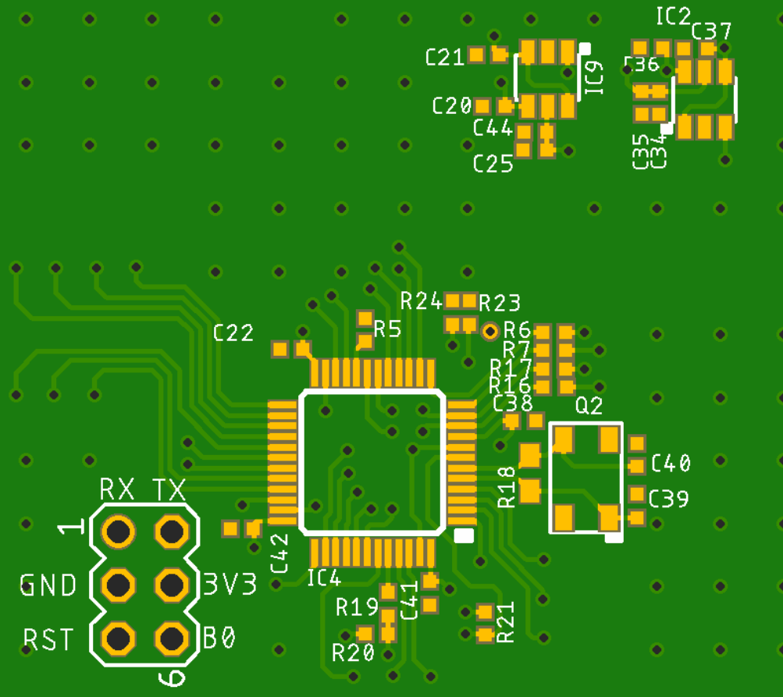
MOUNTING DRAWING - 3

Slide 12
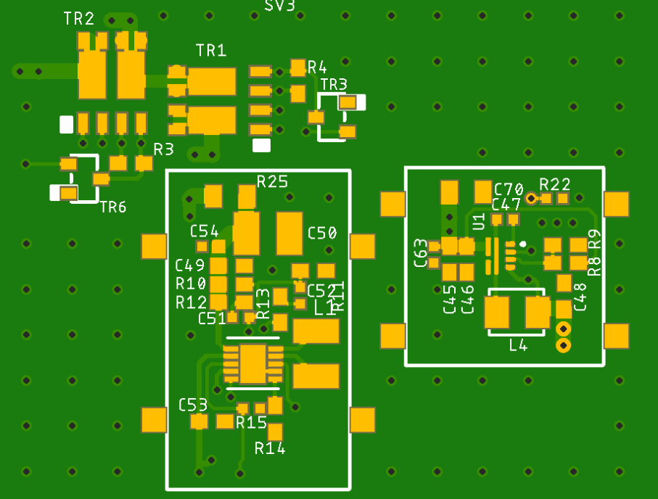
MOUNTING DRAWING - 4

